Slide 1
Rocky Gym Management System
BY
Nairoua Elvis Salaton
P15/1729/2017
Supervised
by
Dr. Stephen Mburu

Slide 2
Background Information
The internet has grown rapidly over the years, and due to this, online services have become a competitive edge between various organizations.
The gym management system provides a platform for ease of interaction between the admin and trainers/users

Slide 3
Problem Statement
Today, we have too many gyms using a manual management of it’s progress.
If this problem is ignored, resources will need to increase to handle the spreading problems, and we may fail to control critical details that need their privacy.
Without an effective system to help manage a gym, a lot of time will be wasted on data entry and searching, since there will be a lot of entries and also report generation. There will be little efficiency with high costs and also increased paperwork.

Slide 4
Justification
This system has a great data collection and record keeping activities that must be stored for future references
The time used to look for items would be put to better use
Accurate, consistent, desired content in a timely manner use of trusted sources due to reduced data redundancy.
Effective reduction on paperwork

Slide 5
Project Goal
To develop a system that will provide a platform for gym members where they can sign up and enrol to their preferred classes and admin whereby they have the control over all data in the system
To reduce Paper Work in the system.

Slide 6
Project Objectives
To design a system that will;
Facilitate secure storage of data
Store record of the classes and equipments around the gym
Help users to enrol into classes and plan their programs

Slide 7
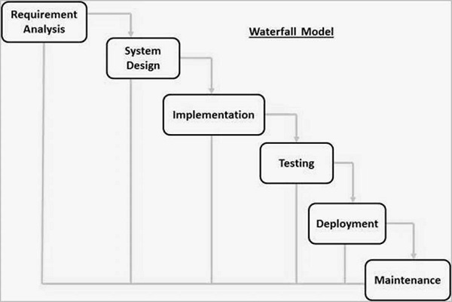
Methodology
Waterfall method was used

Slide 8
System Analysis and Design
The following were drawn
Use case Diagrams
Data flow diagrams
Flowcharts

Slide 9
Resources Used
Sublime text editor
Draw.io, moqup
Operating system I.e Linux Ubuntu 16.04
HTML5, css3,JavaScript/Jquery
Node JS (Backend)
MongoDB

Slide 10
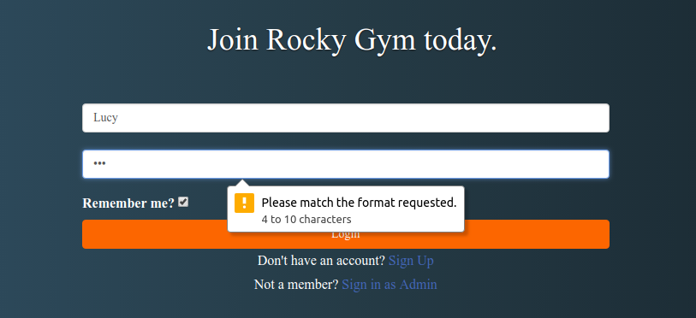
Implementation testing
Unit testing = BlackBox + White Box
Cross browser compatibility Testing on Mozilla firefox, Chrome and chromium
Performance Testing
Error testing

Slide 11
Recommendation and Conclusion
With more resources, it will be able to intergrate the payments module and use of chart JS to generate better charts as the reports
Incorporation of social media plugins

Slide 12
References
(n.d.). Retrieved from Samtofitness: http://www.samtofitness.com/
(n.d.). Retrieved from SmartGyms: http://www.smartgyms.co.ke/
(n.d.). Retrieved from Business Daily:https://www.businessdailyafrica.com/

